Slide 1

IT Job Reviews Analysis
Project 2
Present by
Date
Lê Đức Anh & Trần Anh Tú
21 June 2025

Slide 2

Table of content
01 | Project Overview | 02 | Content-Based Similarity
03 | Recommend or Not Classification | 04 | Deployment (Demo)

Slide 3

1. Project Overview
ITviec background – Objectives - Dataset

Slide 4

Project Overview
ITviec background
ITviec is a leading platform providing job opportunities in the Information Technology (IT) field
This platform is designed to help users, especially developers, develop their careers effectively. Users can easily search for jobs on ITViec according to many different criteria such as skills, job titles and companies. In addition, ITViec also provides many useful resources to support job seekers and self-development.

Slide 5



Project Overview
Objectives
There are 3 main objectives in this project
Content-Based Similarity
Recommend Classification
Deployment (demo)
To suggest similar companies based on description content.
To predict the possibility of "Recommend“ for a company
To develop user-friendly and logical interfaces

Slide 6
Project Overview
Dataset
There are 3 main datasets mostly used in this project
Overview_Companies
Overview_Reviews
Reviews
This is main dataset for Objective 1 “Content-Based” Similarity
English take huge % in reviews
Other features beside company reviews can basically use for filter
This is supported dataset to get insight and overall scoring
This is main dataset for Objective 2 “Recommend or Not”, including….
12 columns
8416 entries
2 Reviews in text: “What I liked” & “Suggestion for Improvement”
04

Slide 7
3. Recommend or Not Classification
Detail of Progress
EDA
Feature
engineering
Preprocessing
Modeling
Reviews
Company
Gap idea
Working Day
Company Size
Overtime Policy
Standard Scaler
One Hot Encoder
Count Vectorizer
KNN
Logistic Regression
Decision Tree
Random Forest
XGBoost

Slide 8
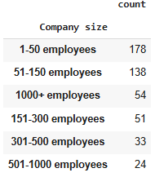
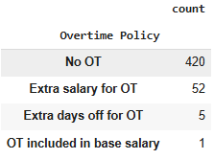
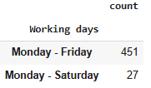
Recommend or Not Classification
EDA
Reviews | Company
Natural Language Preprocessing (Appendix 1) Topic Modeling: LDA (n topic = 3) Clustering: K means (n=3) Outcomes features: like_cleaned (What I liked after preprocessing) like_topic (What I liked after clustering) | Filling null values with mode (object features) Outcomes features: Working Day Company Size Overtime Policy

Slide 9
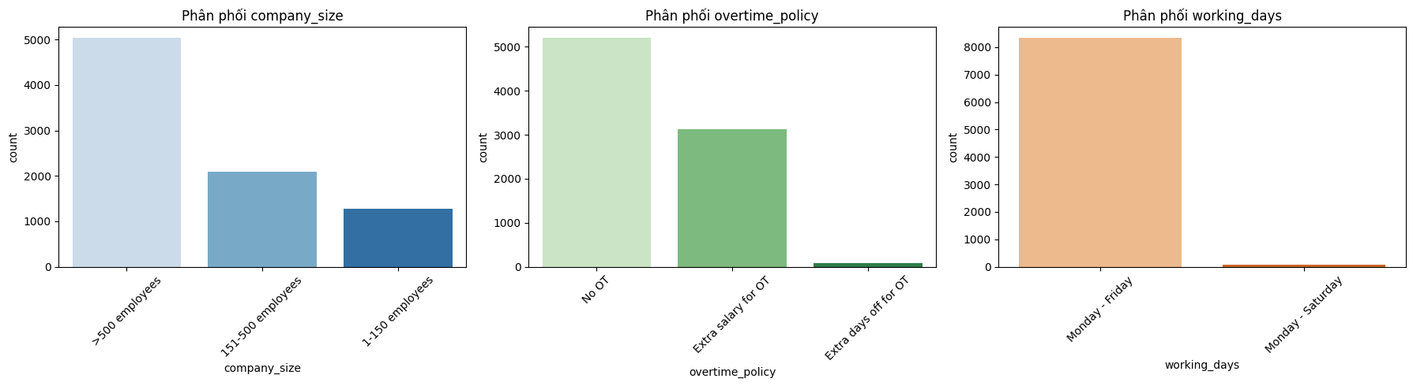
Recommend or Not Classification
Feature Engineering
Numeric | Gap = Actual – Expectation Actual: review rating Expectation: mean rating, salary_benefits, training_learning, management_care, culture_fun
Categorical | OT included in base salary 🡪 No OT Company Size Grouping 1-150 employees 150-500 employees >500 employees
'id',
'rating_gap', 'salary_benefits_gap','training_learning_gap', 'management_care_gap', 'culture_fun_gap',
'overtime_policy', 'working_days', 'company_size’,
'like_cleaned','like_topic',
'Recommend?'
06

Slide 10
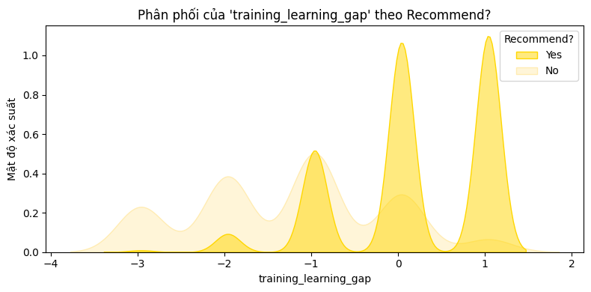
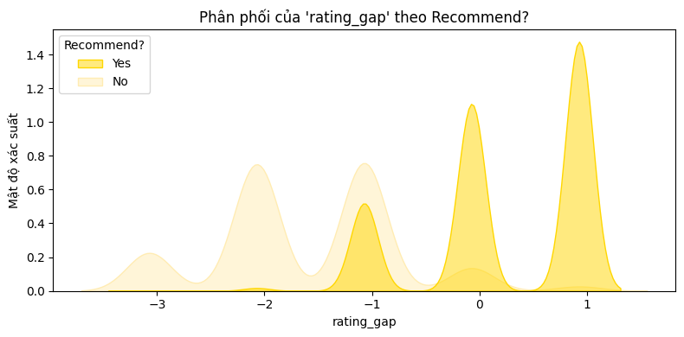
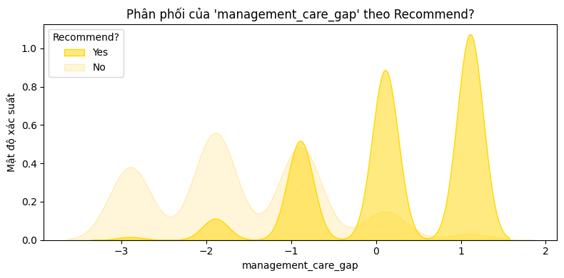
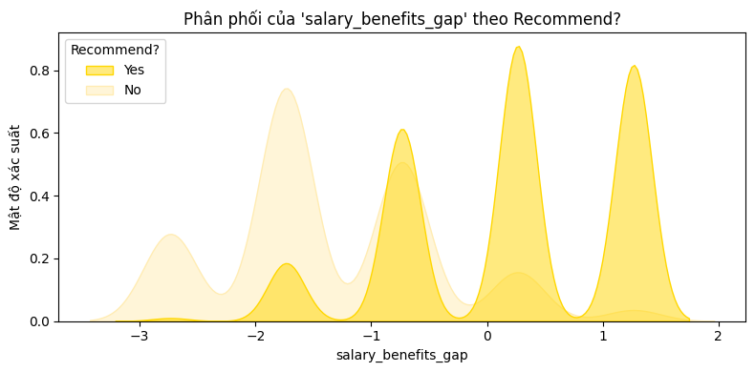
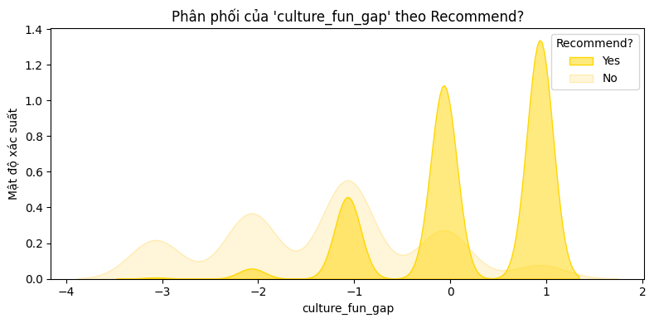
Recommend or Not Classification
Feature Engineering

Slide 11
Recommend or Not Classification
Feature
Preprocessing
Numeric
Categorical
Text
Numeric: 'rating_gap', 'salary_benefits_gap', 'training_learning_gap’, 'management_care_gap', 'culture_fun_gap'
Categorical: 'id', 'overtime_policy', 'working_days', 'company_size', 'like_topic’
Text: 'like_cleaned’
Target: ‘Recommend?’ (Binary Encode)
Standard Scaler
One Hot Encoder
Count Vectorizer
Pipeline Preprocess

Slide 12
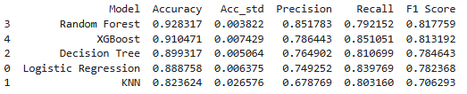
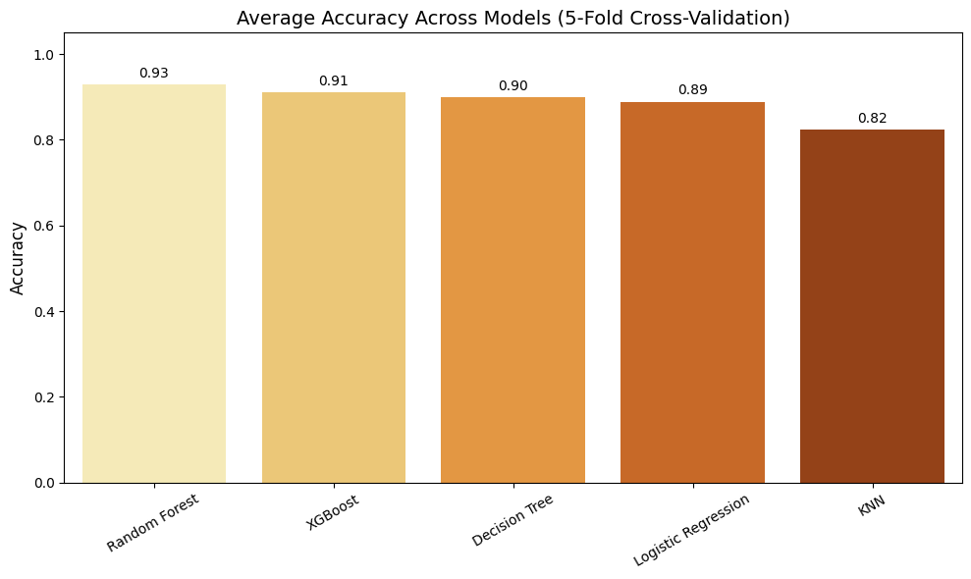
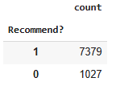
Recommend or Not Classification
Modeling
StratifiedKFold cross-validation on train dataset with oversample

Slide 13
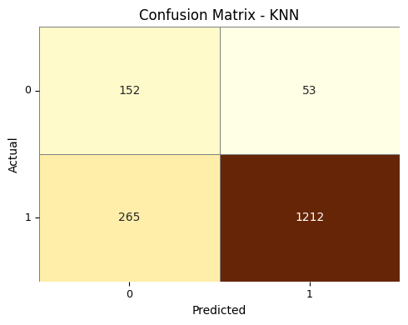
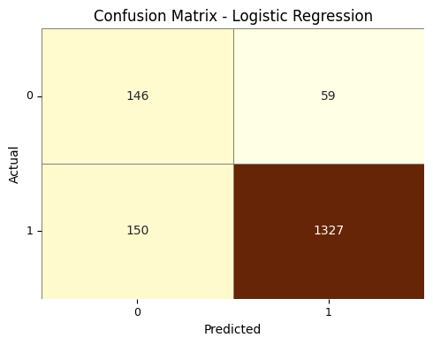
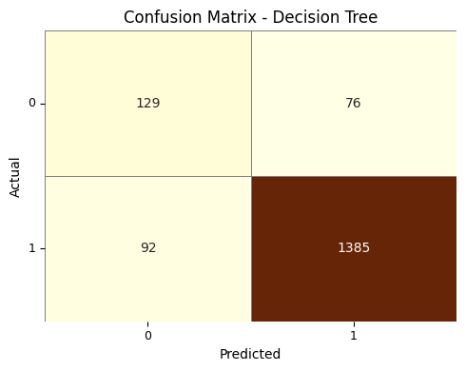
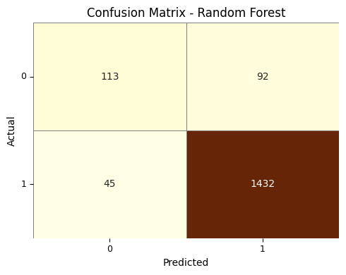
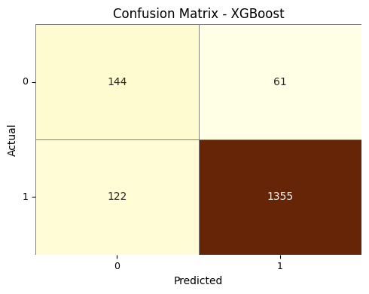

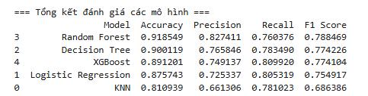
Recommend or Not Classification
Modeling
Result:
Random Forest give the best scores
Doing Grid Search to improve final model

Slide 14
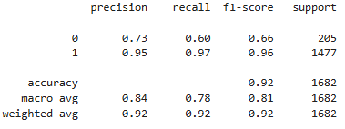
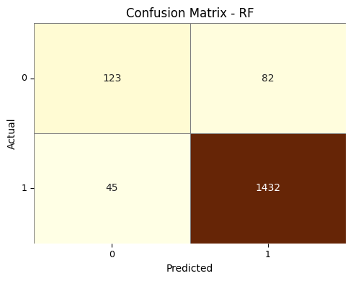
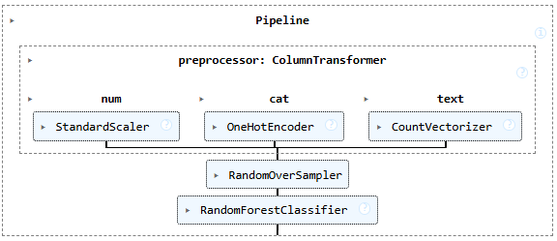
Recommend or Not Classification
Modeling
Grid Search result:
Best F1_macro score: 0.816
bootstrap: True
max_depth: None,
min_samples_leaf: 1
min_samples_split: 5
n_estimators: 200
*** Modeling with Pyspark in Appendix 2

Slide 15
4. Content-Base Similarity
Detail of Progress
EDA
Feature engineering
Preprocessing
Modeling
Reviews
Company
English Detect -Translate
Remove stop word
Vector Feture Text
TF-IDF vector
Cosine Similarity
Gensim – similarities Matrix

Slide 16
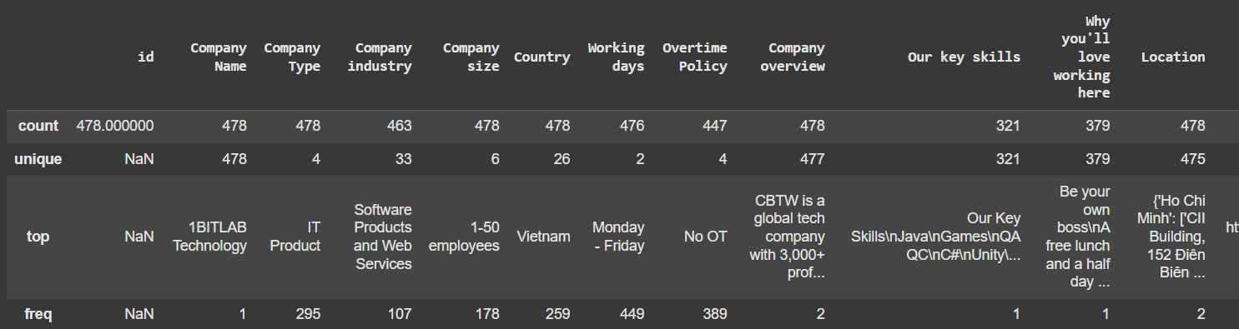
Content-Base Similarity
EDA
Review EDA:
Others features: Company Type, Industry, Size, Country, Working Days, Overtime Policy have small unique -> Can use filter to define group each company

Slide 17
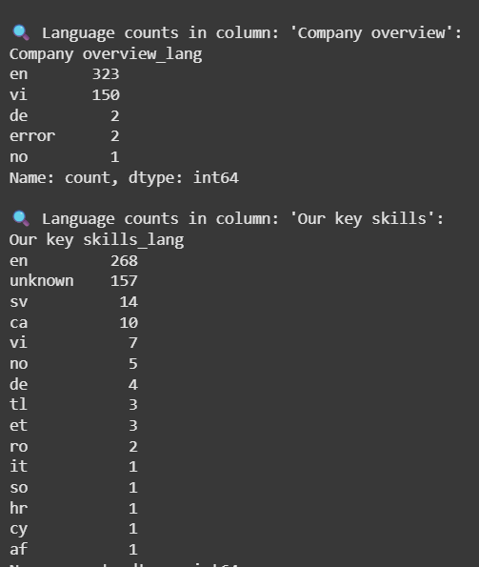
Content-Base Similarity
EDA
Review EDA
English take huge % in total reviews company
Translate all reviews to English and start feature engineering

Slide 18
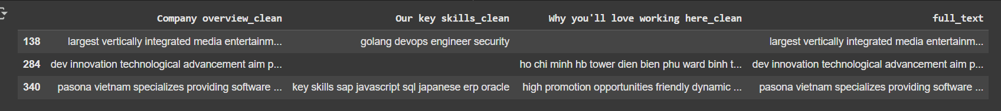
Content-Base Similarity
Feature engineering
Result
Remove stop word in english
Combine 3 column to full_text for vector transform feature

Slide 19
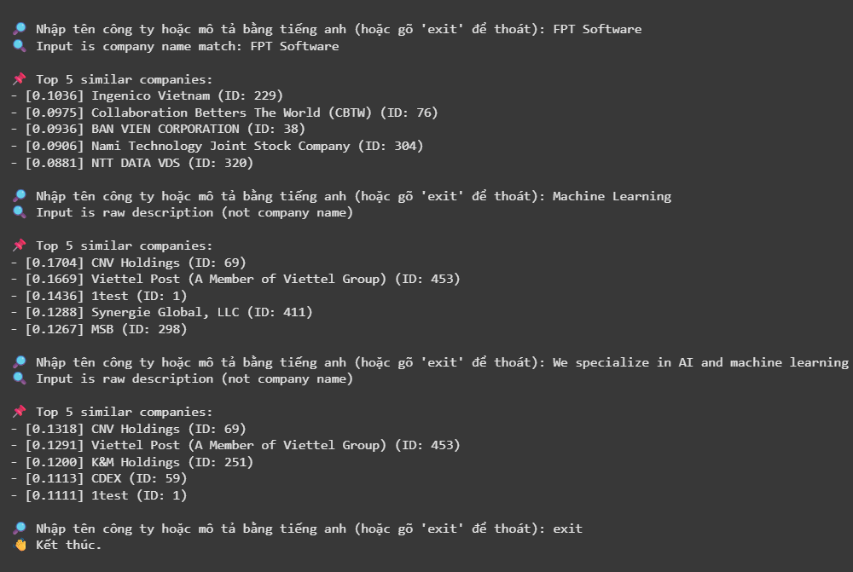
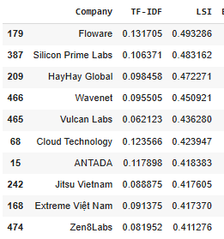
Content-Base Similarity
Preprocessing and Modeling
Result
Model: TF-IDF and LSI
Text deployment: FPT Software – company
Ai – machine learning – Random description

Slide 20




5. Deployment
Demo for Recommend or Not Classification

Slide 21
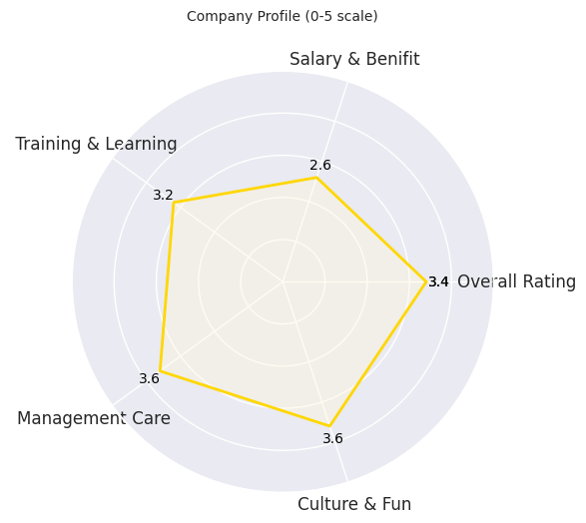
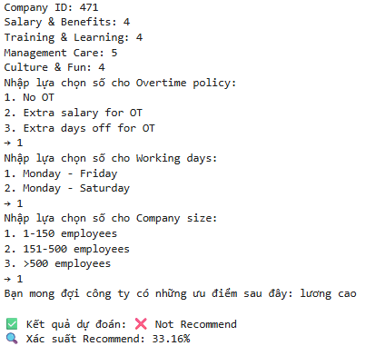
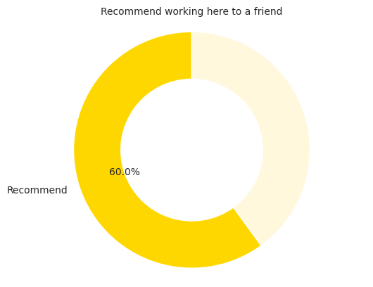
Deployment (Demo)
Deployment
Recommend or Not Classification

Slide 22

Thank you
Q&A

Slide 23
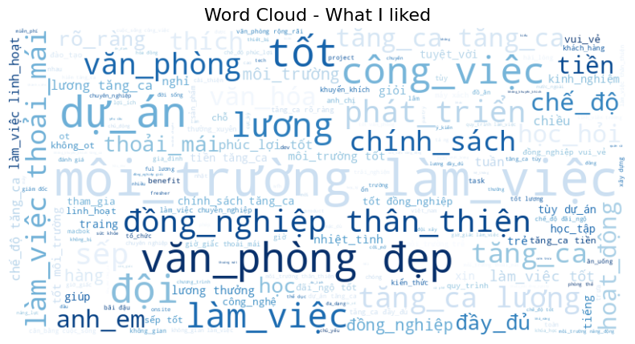
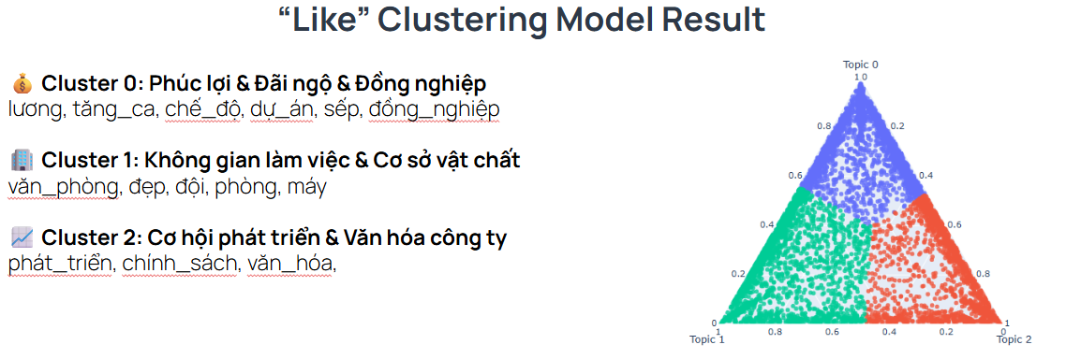
Appendix 1
NLP step:
1. Translating sentence: langdetect + Google Translator
2. Encoding: Unicode UTF8
3. NLP Preprocessing:
Lowercase
Remove repeated characters (eg: thiệtttt → thiệt)
Emoji handing: delete
Convert teencode
Delete Punctuation & Numbers
POS tag + process special words ['không', 'chẳng', 'chả', 'chưa', 'thiếu', 'hơi']
Clustering: 'N','Np','A','AB','V','VB','VY','R'
Translating words
Delete stop words
Delete wrong words
Delete excess blank space

Slide 24
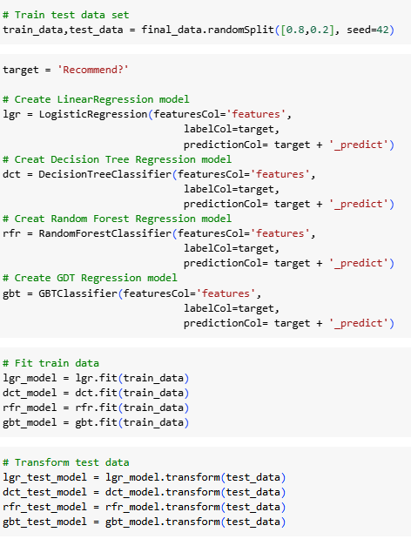
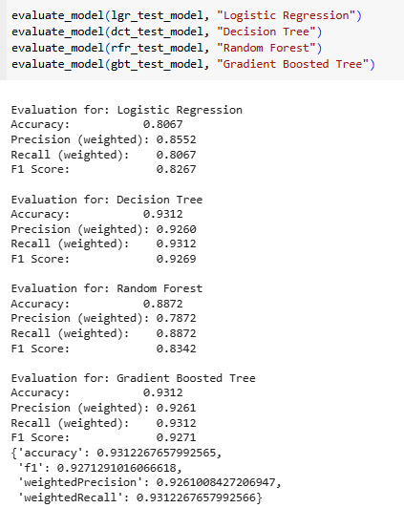
Appendix 2
Modeling with PySpark

Slide 25
Appendix 3
Task Distribution
1. Xây dựng mô hình (Modeling)
Đức Anh: Xây dựng mô hình Content Base
Tú: Xây dựng mô hình Recommend or Not Classification
2. Thiết kế slide báo cáo (Slide Design)
Đức Anh: Slide phần giới thiệu & mô tả dữ liệu Slide phần Content Base
Tú: Slide phần Recommend or Not Classification
3. Thuyết trình (Presentation)
Đức Anh: Trình bày phần giới thiệu dữ liệu Trình bày phần Content Bast
Tú: Trình bày phần Recommend or Not Classification

